Slide 1
Manufacturing Gender in Commercial and Military Cockpit Design

Slide 2
Introduction
Rachel N. Weber is a Professor of Urban Planning and Policy, University of Illinois at Chicago.
She explains in this article gender biases built-in the design of the both civilian and defence cockpit.
Acc. to Weber, many feminist scholars have linked military technologies as instrument of wars with male desire to dominate.
Acc. to Weber, this deterministic view needs to be challenged as acc. to her the military technologies are socially constructed to be inherently masculine.
Acc. to Weber, for example the Pentagon officials and engineers have built these biases against women bodies by making certain specifications in the guidelines of design which favour male bodies than female bodies.

Slide 3
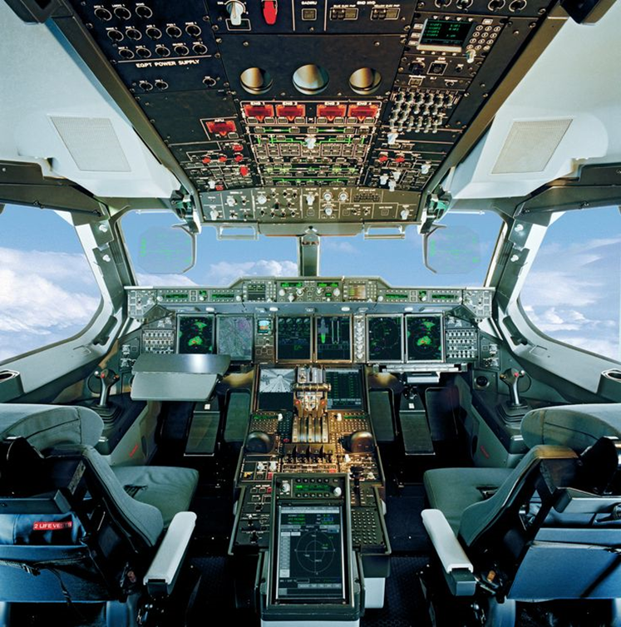
Acc. to Weber, design biases are not only found in military technologies but also in commercial technologies (aircraft), automobiles and architecture.
Picture of a military cockpit with switches on the top of the aircraft, seats placed at certain distance from the control panel, etc. which exhibit a design pattern that we will discuss later.
Source: https://i.pinimg.com/736x/f7/e1/48/f7e148711a8c46dd89538f6a5c4ece5f--flight-deck-cockpit.jpg accessed 31 August 2017.

Slide 4

Acc. to Weber, civilian and defence aircraft have been built with male specifications.
Acc. to Weber, women tend to be shorter, have smaller limbs and less upper body strength thus these designs do not accommodate these qualities of users reaching out for buttons and pulling certain levers.
Picture depicting civilian aircraft design
Source: http://reportal.pl/wp-content/uploads/2015/01/kabina_pilota.jpeg accessed on 31st August 2017.

Slide 5
Acc. to Weber, these biases in the designs of cockpits came due to the implementation of ergonomics and anthropometrics by the engineers.
‘Ergonomics, also called “human factors,” addresses the human characteristics, expectations and behaviours in the design of items which people use” (p.237).
Acc. to Weber, ergonomics gained popularity during the World War II period when it was found that even the trained personnel could not operate the complicated machines. Thus, designs were made more human-friendly.
Anthropometrics refers to the measurement of physical characteristics of the body such as the space that one average human would need to fit into the machine, the energy needed to operate different switches, function of age, sex and other demographic functions that form an important aspect of design.

Slide 6
Acc. to Weber, the Department of Defence in US mandates that designs of machine should focus on the capabilities as well as the limitations of the human operator.
Acc. to Weber, the guidelines suggested by the Military Standard 1472 reflect that only 10 percent of the population will not be able to use the machine where 5 percentage of each being either very tall or very short.
Acc. to Weber, women are small in each physical dimension than men, women are considered ineligible for these professions.
She gives the example of Joint Primary Aircraft Training System (JPATS) which was publicized for its military design biases against women.
The minimum sitting height requirement in order to safely operate cockpit controls and eject was according to the average male specifications making aviation careers in Navy or Airforce difficult for women.

Slide 7
Acc. to Weber, “one of the obstacles to over- coming design bias against commercial women pilots is the lack of compre- hensive anthropometric data for civilian female populations”(p.240).
Acc. to Weber, commercial manufacturers even do not have any conclusive data regarding the total population of women commercial pilots, let alone their body dimensions.
Acc. to Weber, there are differences between a commercial and military cockpit.
Acc. to Weber, the commercial aircraft do not reach the same high speed as military planes and they do not contain any ejection seat.
Again she points out that the seats in a commercial cockpit are adjustable to meet the varied comfort and safety requirements of the users and can accommodate a variable population (women).

Slide 8
Acc. to Weber, despite the adjustable seats commercial cockpits have various switches located at flight deck which might be a problem for women who are short in height or men who are of small-statured.
Acc. to Weber, “cockpit design specifications have protected what has traditionally been a male occupation. Because both commercial and defense aircraft have been built for use by male pilots, the physical differences between men and women serve as very tangible rationales for gender-based exclusion”(p.241).
The military, cockpit technology had to be adjusted to the entry of women into the armed forces and their new roles within the services. The process of design accommodation in the military became a process of negotiation between various social groups who held different stakes in and interpretations of the technology in question (Pinch and Bijker 1984).

Slide 9
Interpretative flexibility means that each technological artifact has different meanings and interpretations for various groups
Bijker and Pinch showed that the air tire of the bicycle meant a more convenient mode of transportation for some people, whereas it meant technical nuisances, traction problems and ugly aesthetics to others.

Slide 10
The negotiations over accommodation arose as a result of changes made in policies regarding women in combat.
Weber pointed out that the Former Secretary of Defense Les Aspin publicly recognized then that women should play a greater role in the military and issued a directive in April 1993 on the assignment of women in the armed forces.
the services shall permit women to compete for assignments in aircraft, including aircraft engaged in combat missions. The Army and Marine Corps shall study opportunities for women to serve in additional assignments, including, but not limited to, field artillery and air defense artillery. (Aspin 1993)

Slide 11
Although the new policy gave women a greater combat aviation role and was intended to allow for their entry into many new assignments, the aircraft associated with these assignments precluded the directive from being implemented.
The realization that existing systems could contain a technological bias against women's bodies despite the Congressional mandate for accessibility alarmed policy specialists at the Pentagon.

Slide 12
In May 1993 the Under Secretary of Defense (Acquisition) directed the Assistant Secretary of Defense (Personnel and Readiness) to develop a new JPATS sitting height threshold which would accommodate at least 80 percent of eligible women. He delayed release of the JPATS draft Request for Proposal until a new threshold could be documented.
This move led to the establishment of the JPATS Cockpit Accommodation Working Group which included representatives from the Air Force and Navy JPATS Program Offices as well as from service acquisition, personnel, human factors, and flight surgeon organizations.

Slide 13
After months of deliberation, the Working Group determined that a reduction of the sitting height requirement by 3 inches would accommodate approximately 82 percent of the eligible female population (Department of Defense 1993).
Reducing the operational requirements would entail modifying existing cockpit specifications. Significant modifications were needed because the requirement for an ejection seat restricts the possibility of making the seat adjustable. In addition, the aircraft nose, rudder, and other flight controls would also need to be substantially modified to accommodate a smaller person.

Slide 14
Acc. to Weber, the directive in April 1993 gave women a greater chance of choosing aviation career by providing scope. However, the biases in the design of the cockpit was then not considered as a factor affecting women’s participation in aviation.
The women's groups both within the military and outside supported the decision to alter the JPATS sitting height requirement on ideological grounds.

Slide 15
Some senior defense officials opposed such a change because they believed that such alterations would delay the development of the JPATS, would raise the price of training, and would be prohibitively expensive.
In opposition to these officials, pragmatists within the Pentagon- including most members of the Working Group-argued that it was both efficient and economical to integrate human factors into acquisition.

Slide 16
Design changes, they claimed, would not only benefit women assigned to weapons systems originally designed for male operators, but would benefit smaller men as well. Studies have shown that smaller men also have difficulty operating hatches, damage control equipment, and scuttles on ships.
The pragmatists were quick to emphasize that the inclusion and accommodation of smaller men would be necessary given changes in the ethnic and racial makeup of the nation.

Slide 17
Pragmatists also pointed to the prospect of foreign military sales to countries with smaller-sized populations, which would make design accommodation an important economic consideration as well.
In pursuing this line of argument, they essentially neutered the discourse, erasing the specificities of women's bodies. By refusing to engage in a gendered discourse and instead emphasizing economic benefits, they hoped to appeal to a broader segment of the population and to a Pentagon traditionally hostile to women's issues.

Slide 18
The women's groups both within the military and outside supported the decision to alter the JPATS sitting height requirement on ideological grounds.
Through informal networks and more formal associations such as the Defense Advisory Committee on Women in the Service (DACOWITS), new groups of activists set about to influence policy decisions about career opportunities for women.

Slide 19
The Tailhook scandal provided the necessary momentum for feminist groups in the military and brought gender issues to the forefront of national debates, the decision to accommodate more women in the JPATS cockpit was not without dissension.
In 1992 navy Lieut. Paula Coughlin claimed on ABC News that while attending the 1991 Tailhook Symposium she had faced sexual harassment. The Tailhook scandal brought sexual harassment and sexual crimes in the military from out of the shadows.

Slide 20
Acc. to Weber, many women’s group argued that physical restrictions which disqualified women will unfairly limit women's mobility in the aviation services.
Acc. to Weber, women’s group also influenced the policy decisions about women’s careers.
Weber also found that certain group of women during those times even asked other women to ignore their difference and prove themselves on gender-neutral terms.

Slide 21
Acc. to Weber, “the debates surrounding accommodation exposed the interpretive flexibility of cockpit design but also demonstrated how the more powerful and pragmatic groups were able to push forth their agenda” (p.245).
Weber found that the accommodation of women pilots in military aircraft depended on the relative power of interest groups and political directives.
Acc. to Weber, in the commercial sector the issue of female accommodation lies at the inter-section of technological capability, labor relations, and profit margins.

Slide 22
Acc. to Weber, accommodation of women in cockpit design is technically feasible, but very costly.
Acc. to Weber, “although firms have the ability to adapt their technology on the drawing board, decisions about whether or not to accommodate women are cordoned off as private decisions based on the whims of management, the desires of particular customers, and the fear of litigation”(p.249).
In this article Weber demonstrates how gender and technology are mutually constructed through the design of the cockpits.

Slide 23
Acc. to Weber, women are not only physically different from men, but this difference also creates barriers to career advancement of women.
Acc. to Weber, both design criteria and the scope of regulation need to change in order to accommodate women in aviation industry.
Acc. to Weber, the regulatory processes can also provide effective avenues for change.
Acc. to Weber, ‘regulating the accommodation of a larger pool of pilots in the concept and design phase would ensure a more equitable outcome than relegating such issues to the "logic" of the market and the courts’ (p.250).

